Slide 1
LEETIFY - CODING PLATFORM
TEAM:
Rutuja Ghate
Lakshmi Gayatri Aishwarya Adduri
Snehashis Lenka
Akhil Talashi

Slide 2
Overview
Leetify is an online platform that provides a collection of coding challenges to help developers prepare for technical interviews. The platform offers a wide range of problems that cover various data structures and algorithms, such as arrays, linked lists, trees, graphs, dynamic programming, and more. Leetify can be used by many software engineers, developers, and students who want to enhance their problem-solving and coding skills. It can also be commonly used as a tool for technical interviews, where candidates are often asked to solve coding problems similar to those found on Leetify.

Slide 3
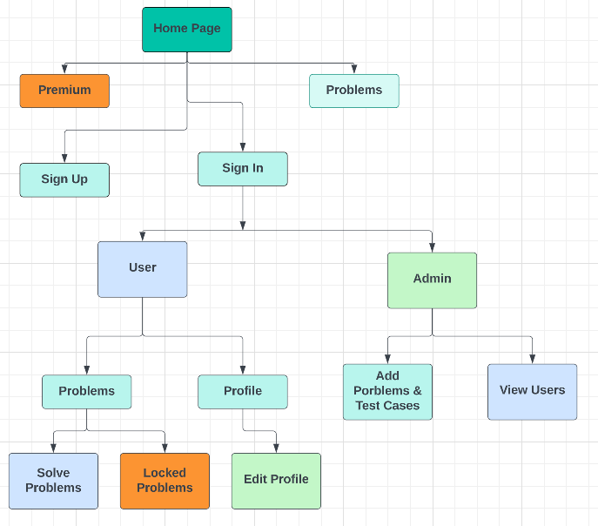
NAVIGATION

Slide 4
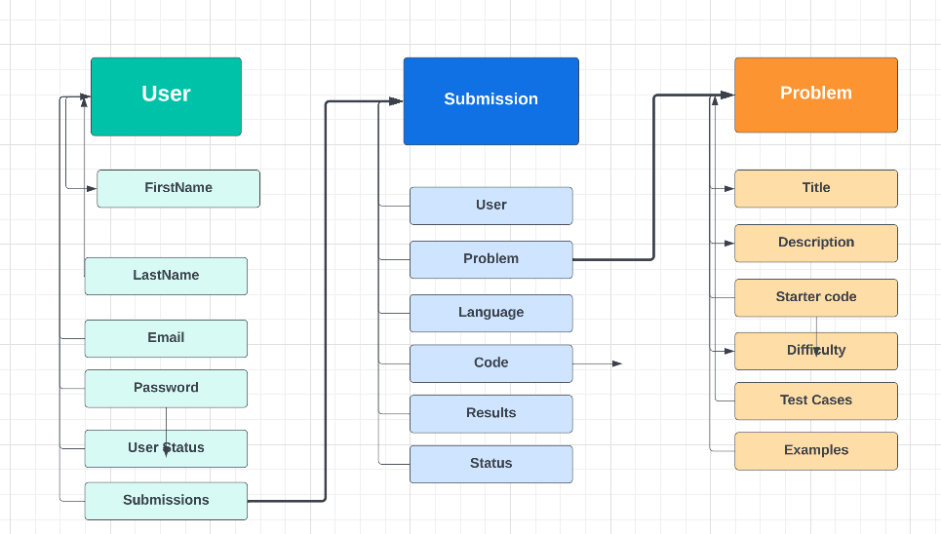
SCHEMA

Slide 5
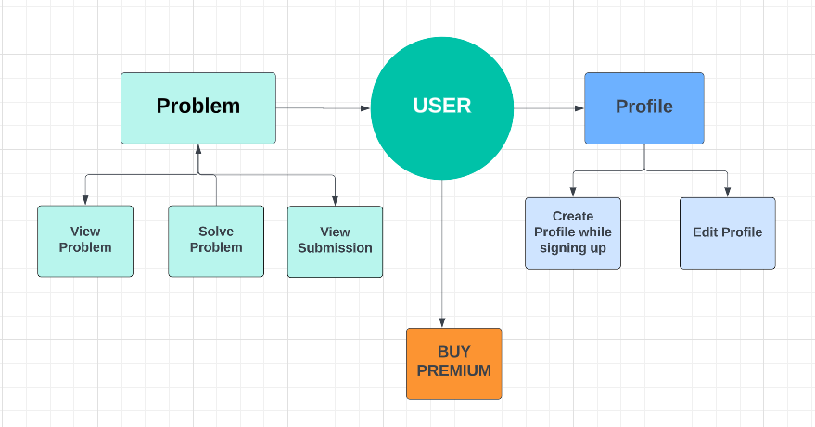
USER FUNCTIONALITY

Slide 6
ADMIN FUNCTIONALITY

Slide 7


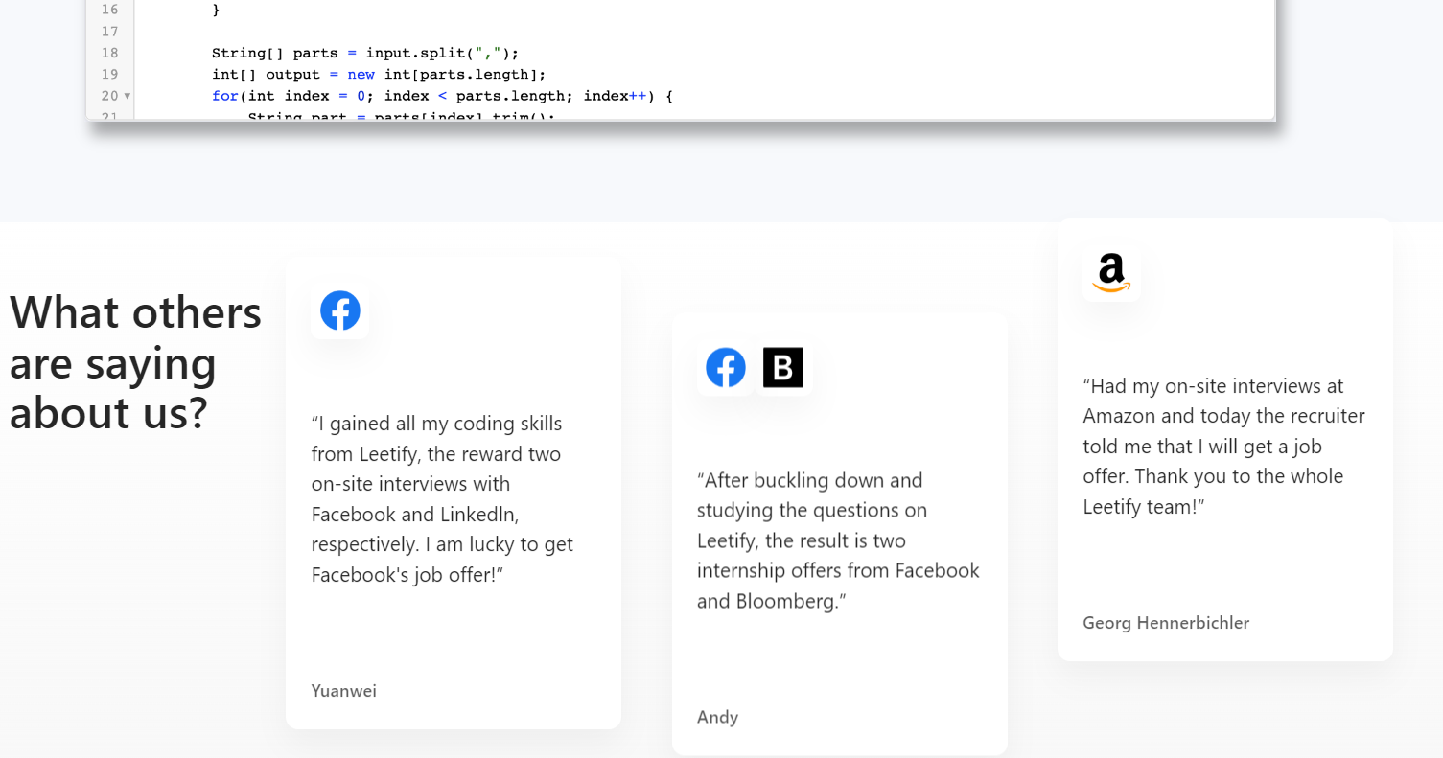

HOME PAGE

Slide 8
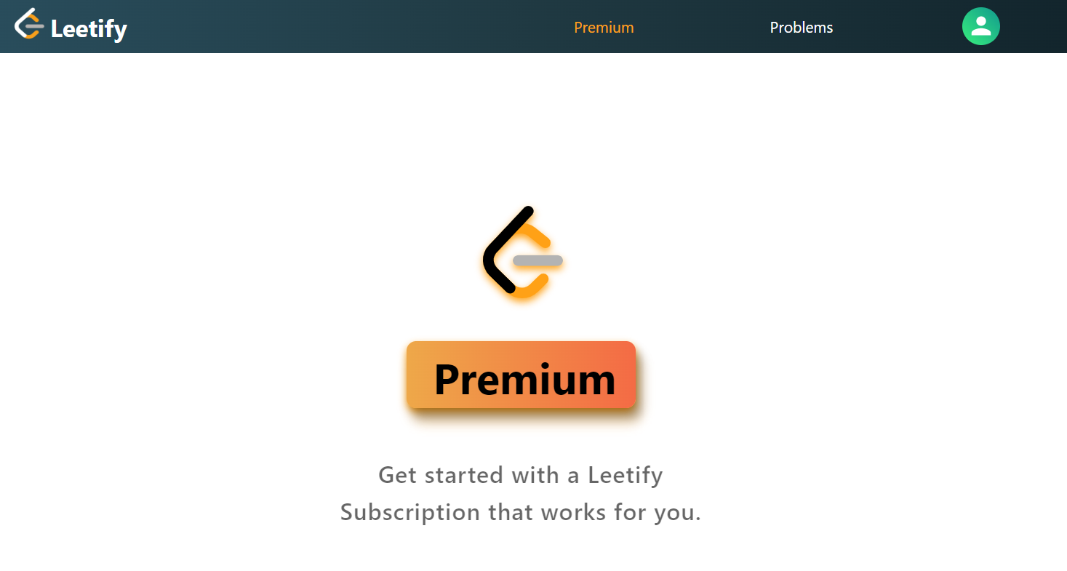
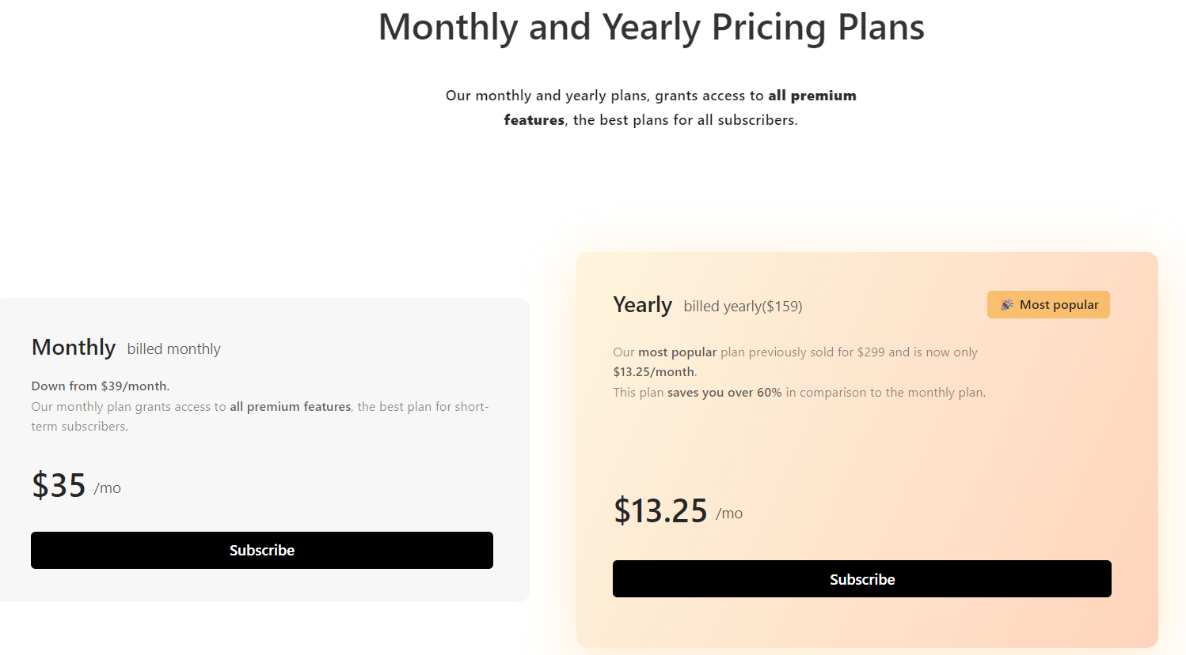
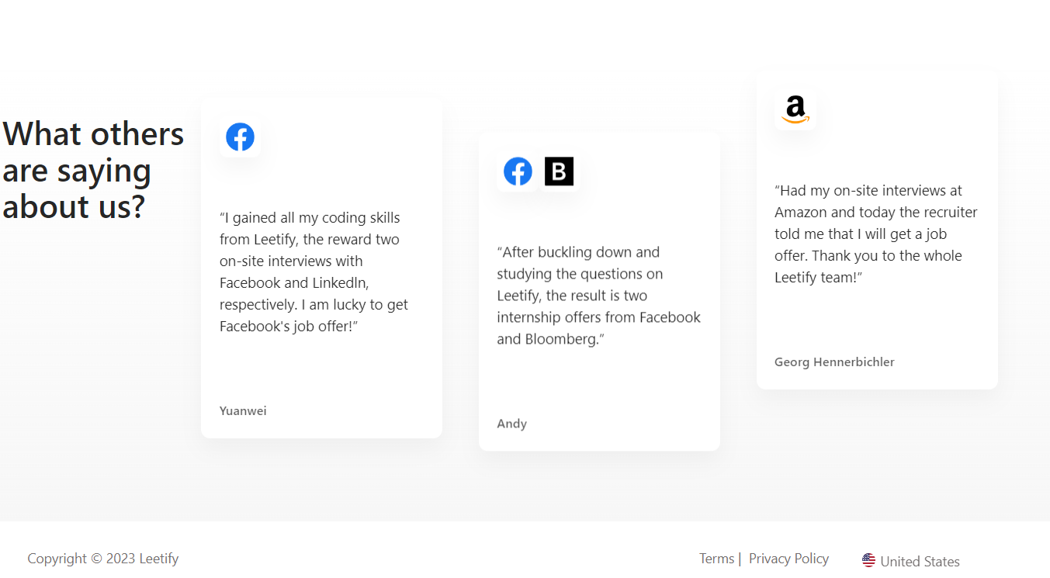
PREMIUM OFFERING

Slide 9
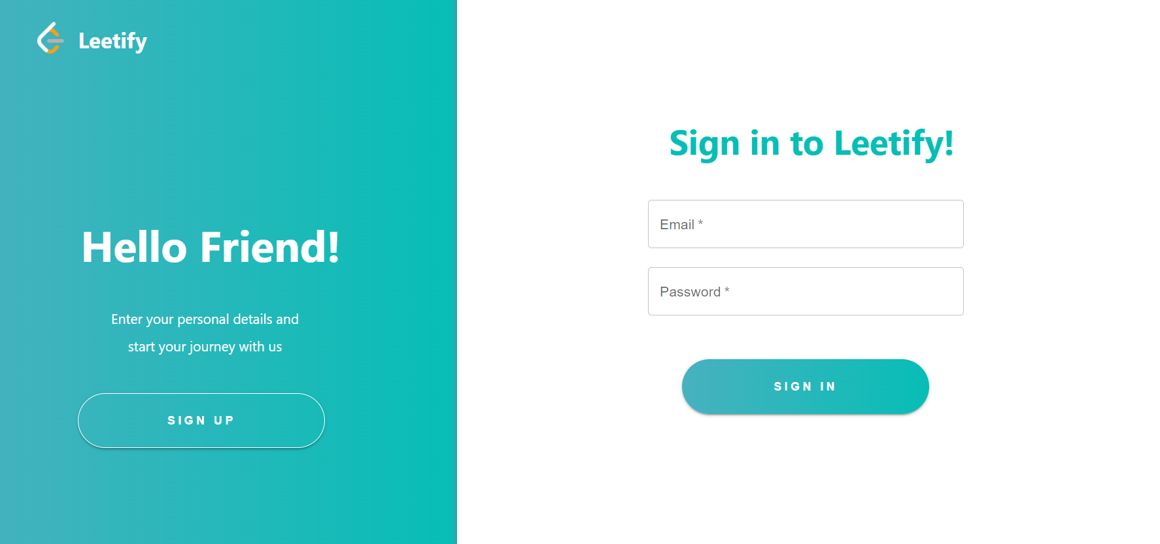
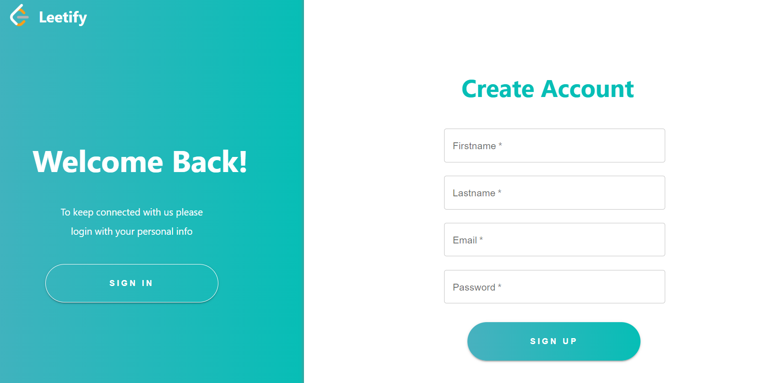
SIGN IN & SIGN UP PAGE

Slide 10
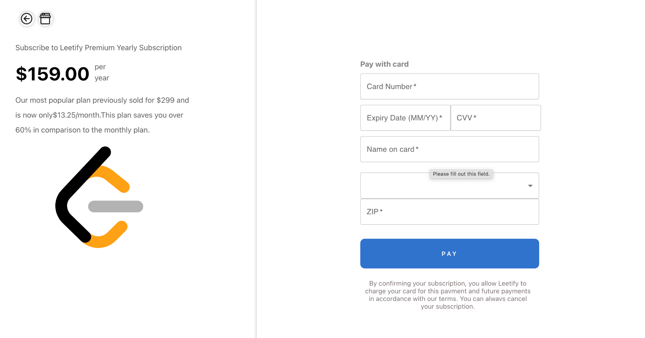
PAYMENT PAGE
When the user clicks the subscribe button in the premium page, the user is directed to the payment page.
The user should have an account first and should be logged in to be able to subscribe for premium offering.

Slide 11
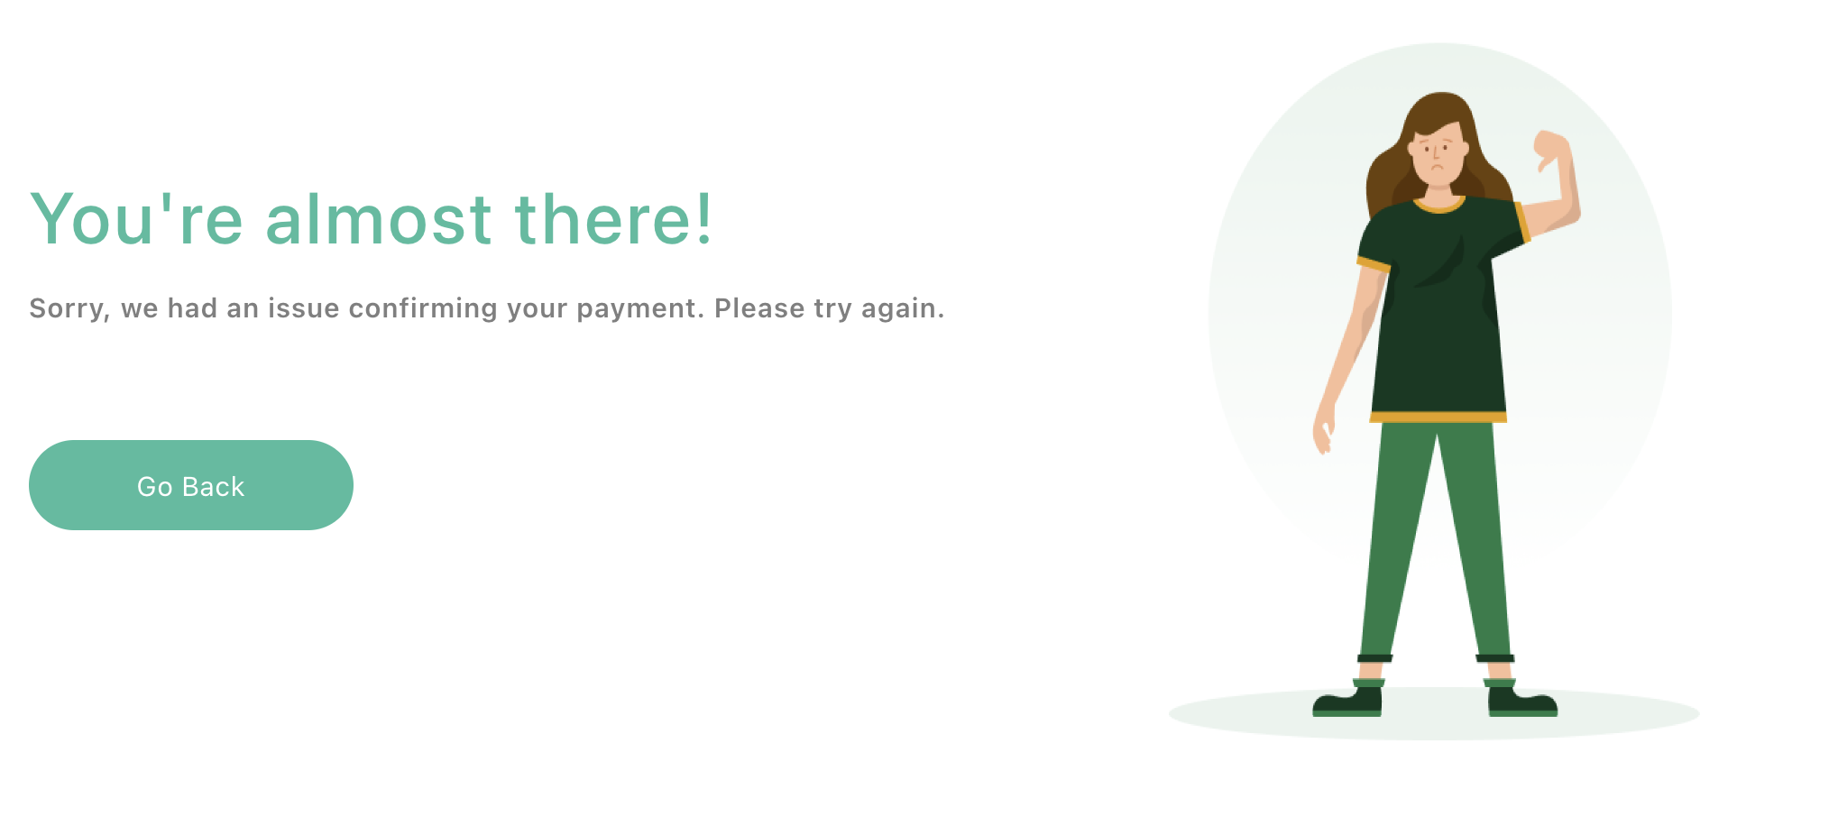
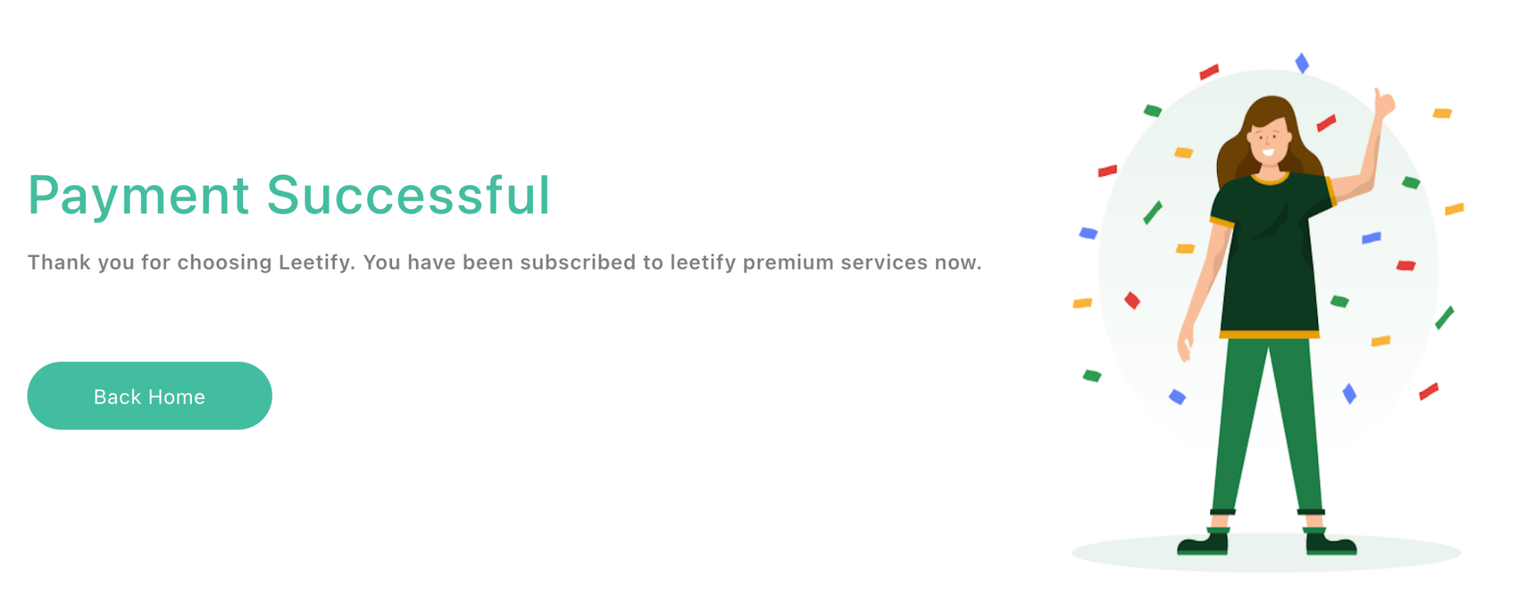
PAYMENT SUCCESS/FAIL

Slide 12
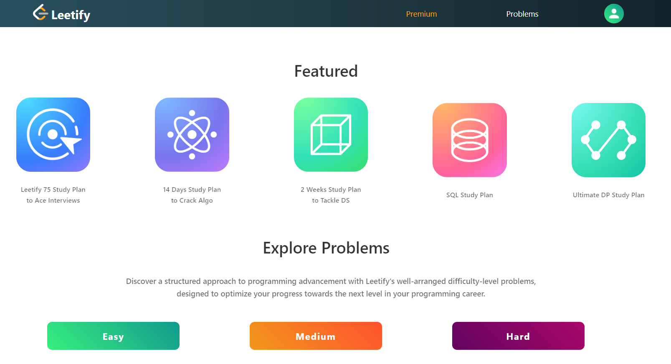
USER-HOME PAGE
User when login is directed to this user-home page which has problems segregated as Easy, Medium and Hard. The navigation bar in on the top allows the user to be directed to the profile page/ Log out.
When a problem is selected, the user is directed to the problem page.

Slide 13
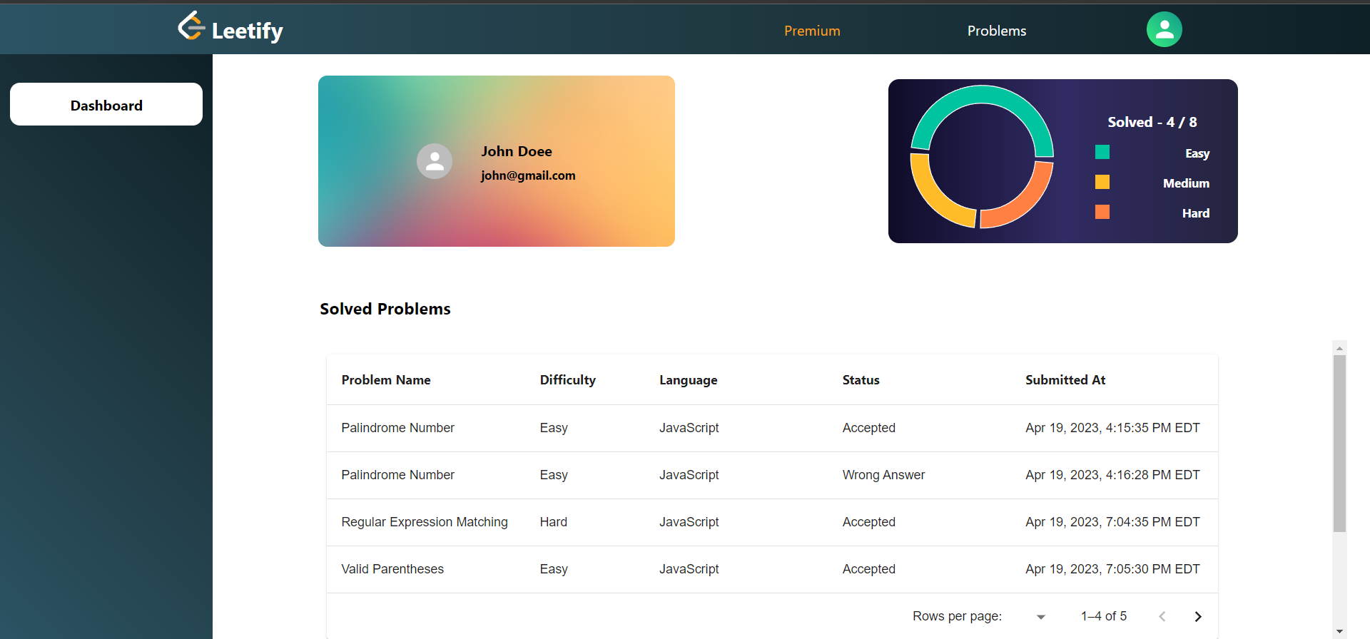
USER DASHBOARD
User can view the problem they solved and the % of correct submission, number of easy, medium or hard problems solved.

Slide 14
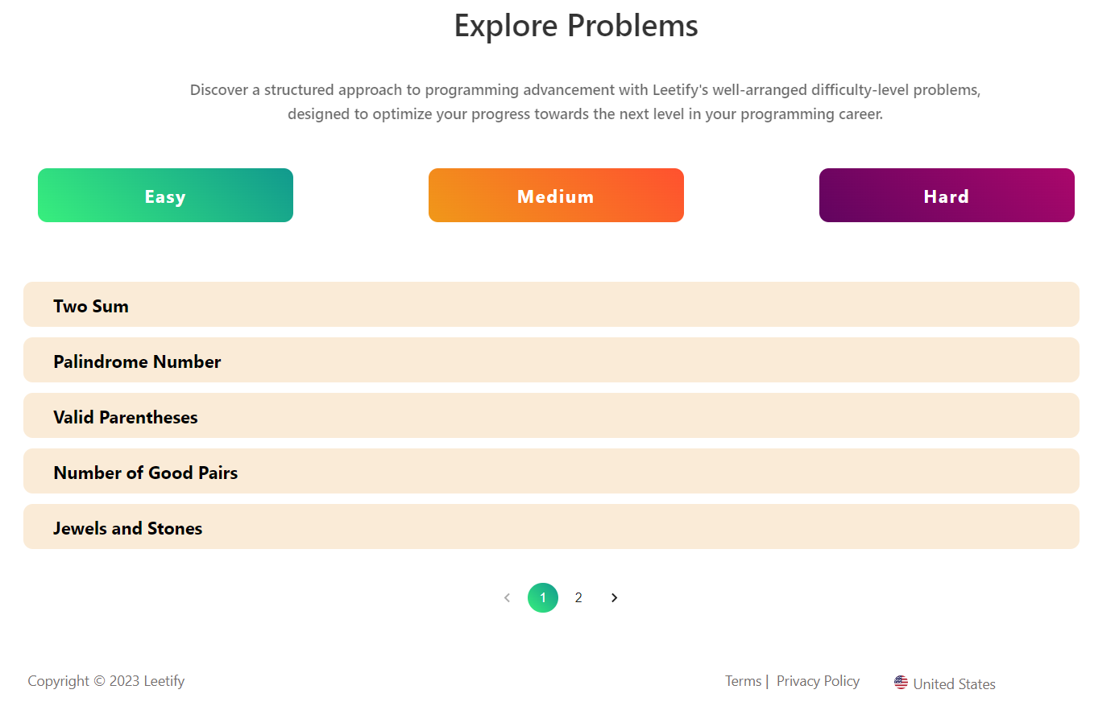
PROBLEMS
Problems are filtered based on the difficulty level and displayed.

Slide 15
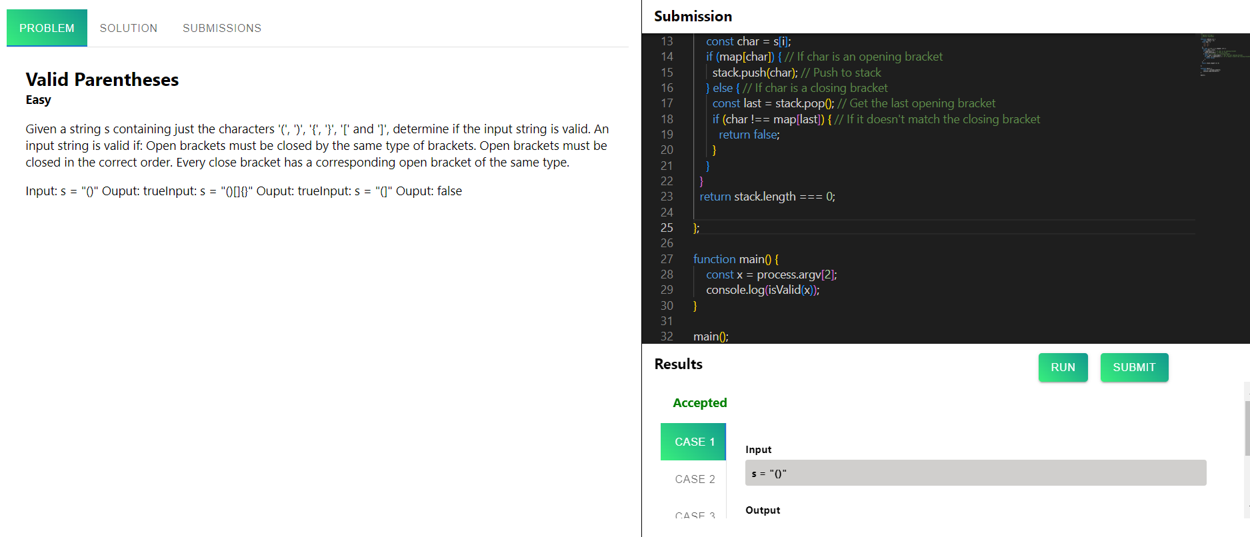
CODE EDITOR

Slide 16
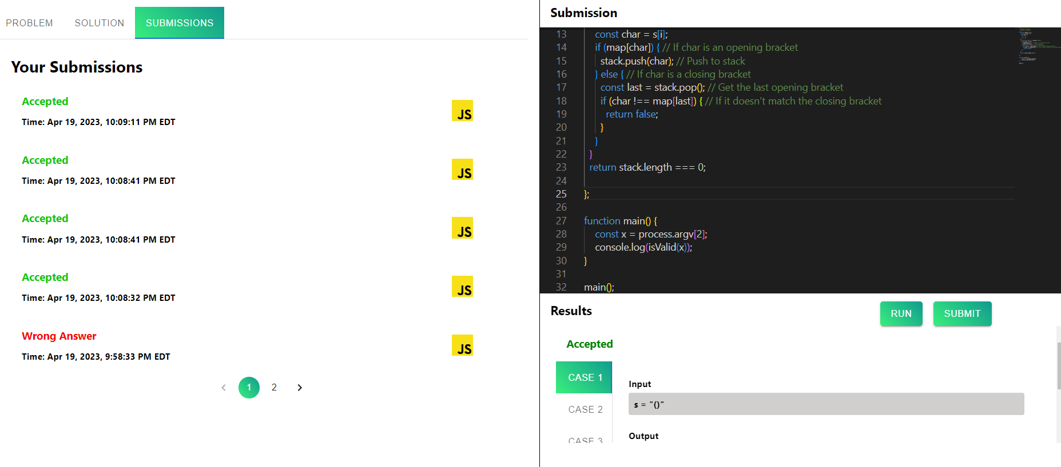
SUBMISSIONS

Slide 17
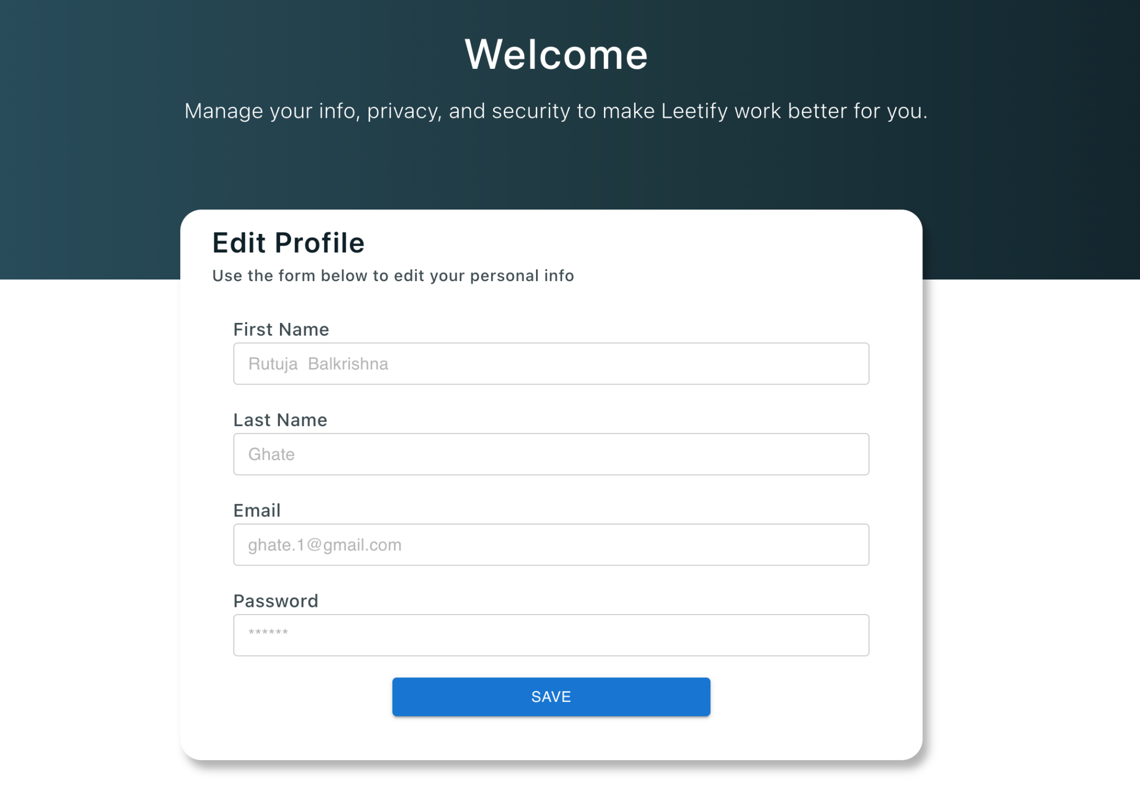
USER-PROFILE PAGE
When the user is logged in and views the profile page, the user is able view their existing details as placeholder values and can update them and save them.
The changes will be reflected in the DB and also in the state object.

Slide 18
PREMIUM OFFERING

Slide 19
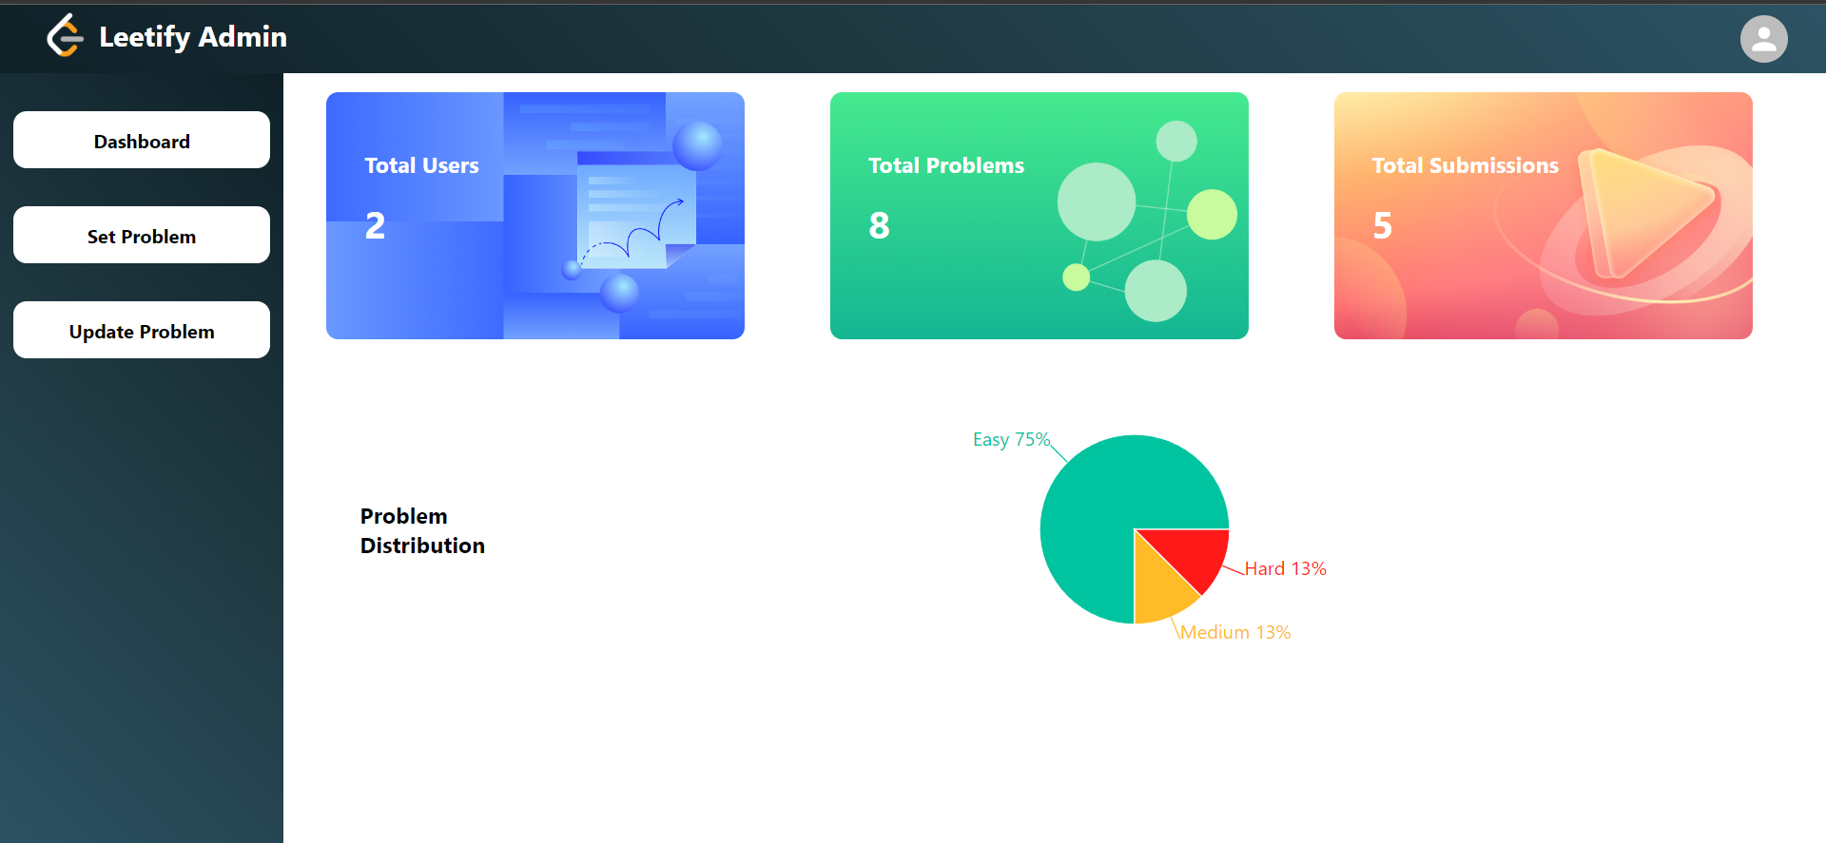
ADMIN DASHBOARD
ADMIN DASHBOARD works as the navigation to Total Users, Total Problems and Total Submissions.
Admin can also navigate to Set Problem, Update Problem

Slide 20
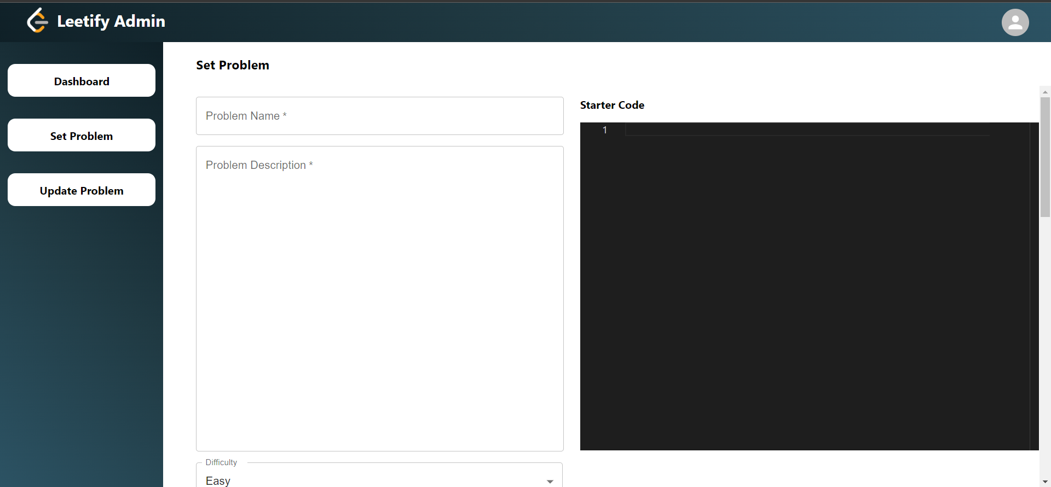
SET PROBLEM

Slide 21
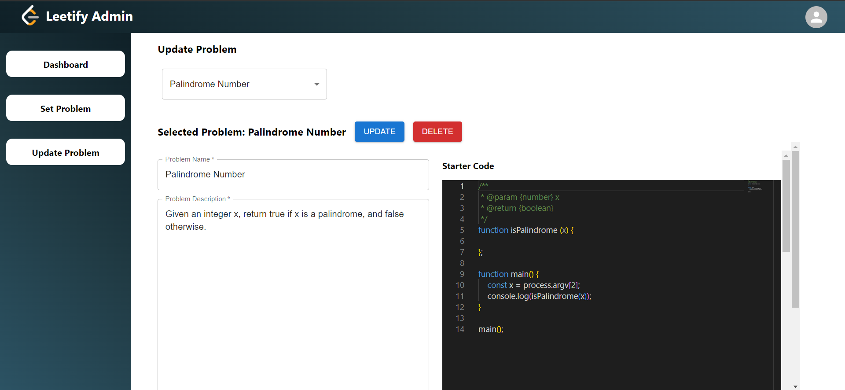
UPDATE PROBLEM

Slide 22
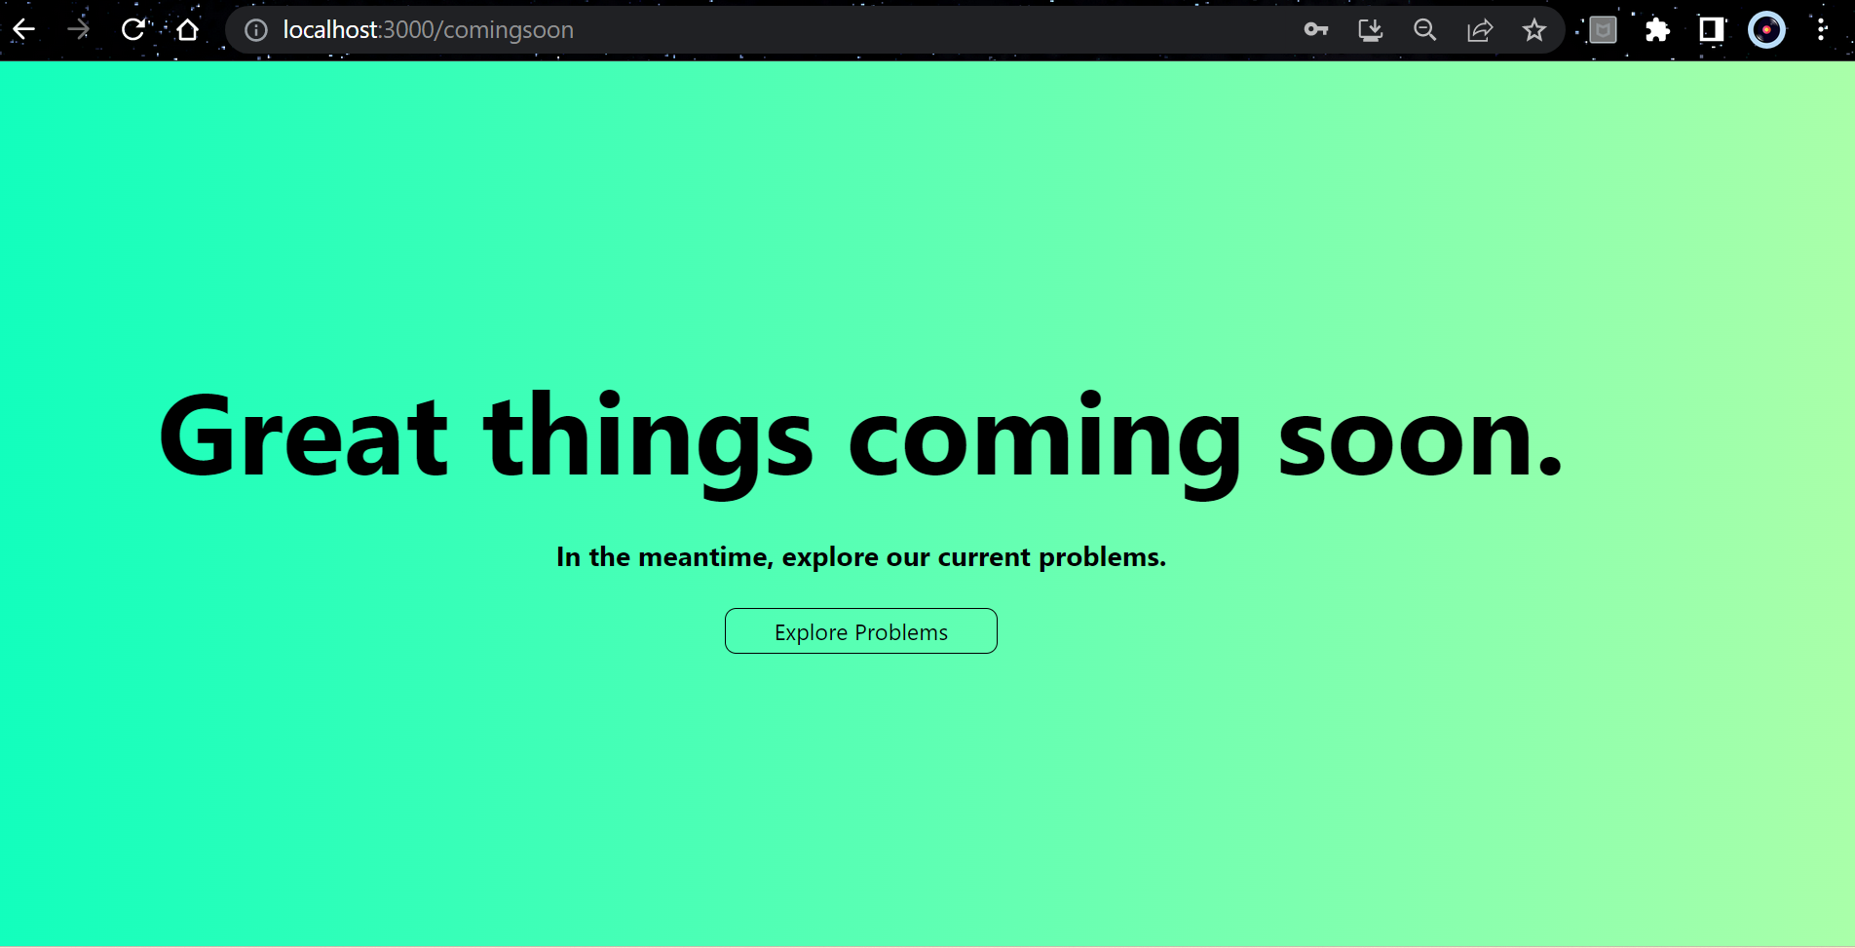
COMING SOON :)

Slide 23



TARGET USERS
Students
Job seekers
Professional developers
Competitive programmers

Slide 24
Thank you!

